Slide 1
PHASE TWO PROJECTS.
Done by:Group 8
Members: Pupity, Collin, Catherine, Shan, Susan
Class: Part-Time Student

Slide 2
Table of Contents
The table of contents of this presentation are:
Purpose for the presentation
Visualization
Model presentation
Linear Regression (Baseline Model)
Simple Linear Regression Visual (2nd Models)
3rd Model
Conclusion
Recommendation
Summary

Slide 3
Predicting House Prices in King County: Evaluating the Impact of Home Features and Renovations using Comprehensive Analysis of multiple linear regression.
INTRODUCTION
The real estate market in King County is dynamic and competitive, with various factors influencing property values. Homeowners and real estate agencies are particularly interested in understanding how different features of a house, as well as renovations, can impact its market value. Accurate and data-driven insights into these factors can significantly enhance decision-making processes for buying, selling, and renovating homes.

Slide 4
PURPOSE FOR THE PRESENTATION
This presentation was constructed for real estate market in king county that is facing a challenge in providing valuable advice to homeowners regarding home renovations. Homeowners often inquire about the potential increase in the estimated value of their homes after making specific renovations or improvements. The agency needs to develop a predictive model that can accurately estimate the impact of various renovation projects on a home's market value within the northwestern county. The goal is to offer data-driven recommendations to homeowners, enabling them to make informed decisions about which renovations to undertake and how these renovations will affect the resale value of their homes.

Slide 5
The business questions to be answered are:
▪How does the number of bedrooms, bathrooms, grade and square footage of a house correlate with its sale price in King County?(This acts as a guidance to home owners on selling or buying or renovation of a house will affect the price.)
▪How much can a homeowner expect the value of their home to increase after a specific renovation project?
▪Which renovation projects have the most significant impact on a home's market value in the northwestern county?
▪Are there specific combinations of renovation projects that provide an interdependent effect on a home's market value?
This project uses the King County House Sales dataset. The file contains information on over 21,000 housing units. The columns used in the analysis are:
✓Price - Sale price (prediction target)
✓Condition - How good the overall condition of the house is. Related to maintenance of house
✓Bedrooms - Number of bedrooms
✓Bathrooms - Number of bathrooms
✓Sqft_living - Square footage of living space in the home
✓Floors - Number of floors (levels) in house
The data set underwent analysis so that meaningful might be drawn. The processes that were done in data analysis were data cleaning(which included handling missing data and outliers), visualization(that show findings within the dataset) and use of models that were used to draw conclusions and recommendations

Slide 6
KEY OBJECTIVES
Create a Home Price Predictive Model:
Build and improve a regression model to precisely forecast King County real estate values depending on a range of property characteristics and remodeling factors. Make that the model is reliable, strong, and has high predicted accuracy.
List the Main Factors Affecting Home Prices:
Determine which characteristics—such as location, number of bedrooms, and square footage—have the most effects on home pricing by analyzing the dataset. Analyze the impact of particular improvements on home values, such as kitchen remodels and bathroom additions.
Give Homeowners Useful Information:
Utilize the model's output to provide homeowners with useful guidance on how to increase the market value of their property through well-chosen upgrades. Determine which upgrades are most cost-effective and provide the best return on investment.
Facilitate Decision-Making in Real Estate Agencies:
Provide the real estate company with data-driven insights so that it may provide clients with more informed purchasing and selling advice. Boost the agency's capacity to advise customers on the types of home upgrades that will most likely raise their property's worth.

Slide 7
OUTLINE
Data analysis and cleaning: Outliers and missing values were handled as the King County House Sales dataset was loaded and cleaned.
Exploratory Data Analysis (EDA): Investigated the connections between attributes and prices and produced a visual representation of the distribution of home prices.
Determined the essential characteristics most closely correlated with home values.
Model Development: Three linear regression models were constructed and assessed.
Model Evaluation: R-squared (R²) and Mean Absolute Error (MAE) were used to evaluate the performance of the model.
Suggestions: gave homeowners and real estate agents practical advice on how to increase house values by emphasizing living space optimization and quality enhancements.

Slide 8
DATA UNDERSTANDING
We will be using using data from the file kc_house_data.csv which contains the prices of houses in King County alongside their features such as year built, year renovated, number of bedrooms and bathrooms, and many more. The full listing of columns and descriptive statistics of the data is shown below.

Slide 9
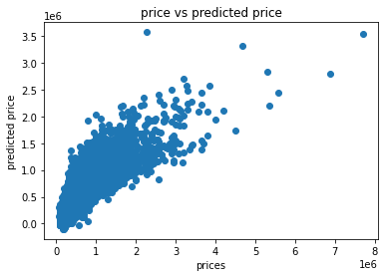
MODELING In this section models were used to find the correlation for each feature in relation to price. A positive correlation will suggest that as the feature increases the price of the property increases was well and that also applies to a negative correlation in that as the feature increases the price of the property tends to decrease
An R-squared value of 0.6515 means that approximately 65.15% of the variance in the dependent variable is explained by the independent variables included in the regression model. This indicates a moderately strong relationship between the predictors and the target variable. However, it also suggests that there is room for improvement, as a significant portion of the variance of 34.85% remains unexplained

Slide 10
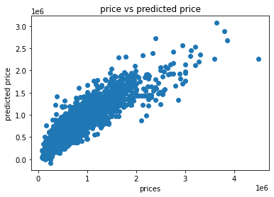
We get an r squared value of 0.82. We note that by including more features, we get a better performing model.
An R-squared value of 0.82means that approximately 82.00% of the variance in the dependent variable is explained by the independent variables included in the regression model. This indicates a strong relationship between the predictors and the target variable. However, it also suggests that there is room for improvement, as a significant portion of the variance of 18.00% remains unexplained

Slide 11
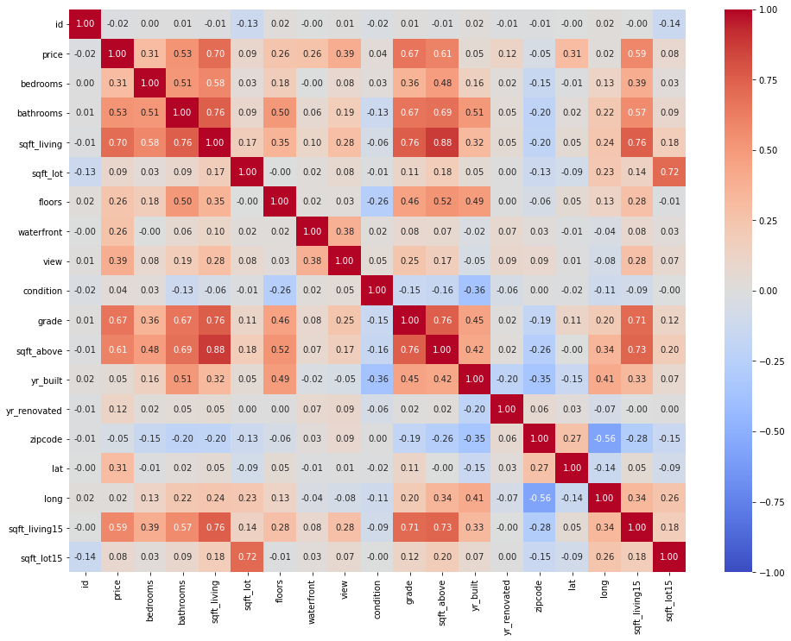
We selected different features to try improve the model performance.
The heat map will visually show the strength and direction of the correlation between each pair of features:
High Positive Correlation (close to 1): Indicates that as one feature increases, the other feature tends to increase as well.
High Negative Correlation (close to -1): Indicates that as one feature increases, the other feature tends to decrease.
Low Correlation (close to 0): Indicates little to no linear relationship between the features.

Slide 12
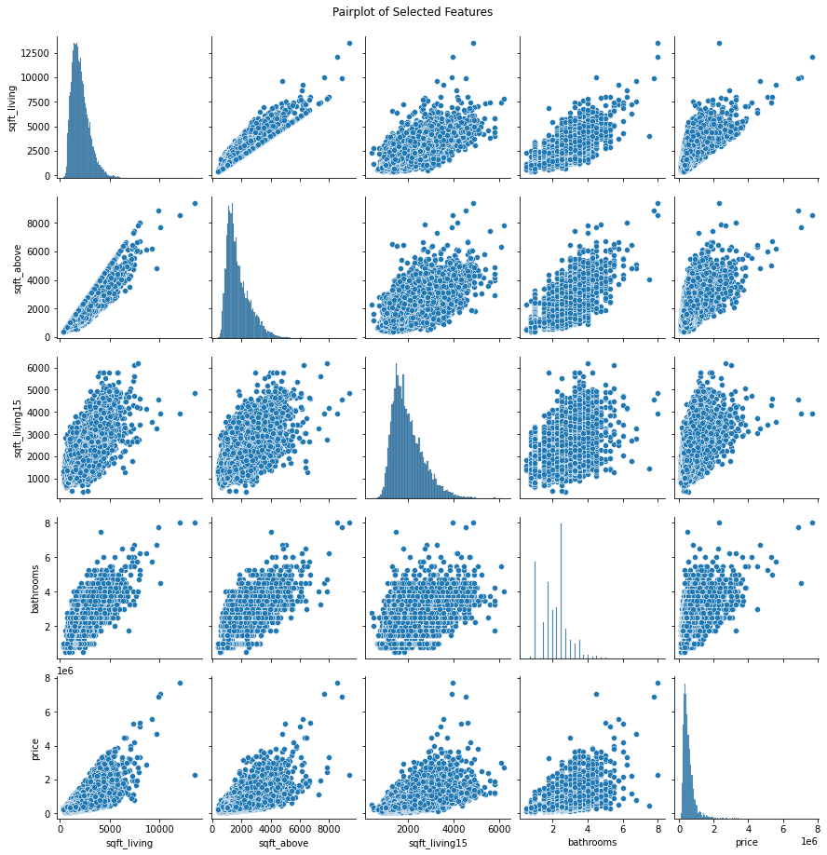
Selected features 1 based on high correlation with price and removing multicollinearity
Scatter plots involving price can highlight which features have strong linear or non-linear correlations with the target variable.
By including the target variable price, you can observe how each feature relates to the house prices.

Slide 13
RECOMMENDATIONS
❖ Pricing Strategies*: Real estate agents can use the insights to set competitive and realistic listing prices. Understanding the key factors influencing house prices, such as square footage, location, and property condition, allows agents to better advise sellers on how to price their homes and buyers on what to expect to pay.
❖ Informed Decisions*: Homebuyers can benefit from understanding the key factors that drive house prices. This knowledge helps them make more informed decisions about which properties to purchase, considering aspects like future resale value and investment potential.
❖Urban Planning*: Insights into how different locations and property attributes affect house prices can inform urban planning and development policies. Policymakers can use this data to promote balanced growth and address housing affordability issues by understanding which areas need more infrastructure or services.
❖Correlation of Bedrooms, Bathrooms, Grade, and Square Footage with Sale Price: They can leverage the third model to explain how the number of bedrooms, bathrooms, the grade of a house, and its square footage correlate with its sale price in King County. They can utilize the model's coefficients and feature importance analysis to explain the correlations between these variables and sale price.

Slide 14
SUMMARY
In conclusion, Homeowners and real estate agents should focus on improving the design and quality of construction of their houses, which may in turn improve their home grade. If possible, they should also expand the square footage of living space on the lot, perhaps by building additional bathrooms.
In summary, the project study suggests that the number of bedrooms, square footage of living area, condition, number of bedrooms, bathrooms and floors are important factors to consider when determining the price of a home. However, it is essential to consider other market factors and property-specific attributes in conjunction with the findings of this analysis to arrive at an accurate and competitive listing price such as architectural style, lot size and landscaping, upgrades and amenities, historical sales data, market trends, school district, crime rate, zoning and regulations.

Slide 15
THANK-YOU
WE HAVE COME TO THE END OF THE PRESENTATION

